Slide 1



Flutter UI Challenges

Slide 2
Agenda
01
List View
02
Text Field
03
ToDo App

Slide 3
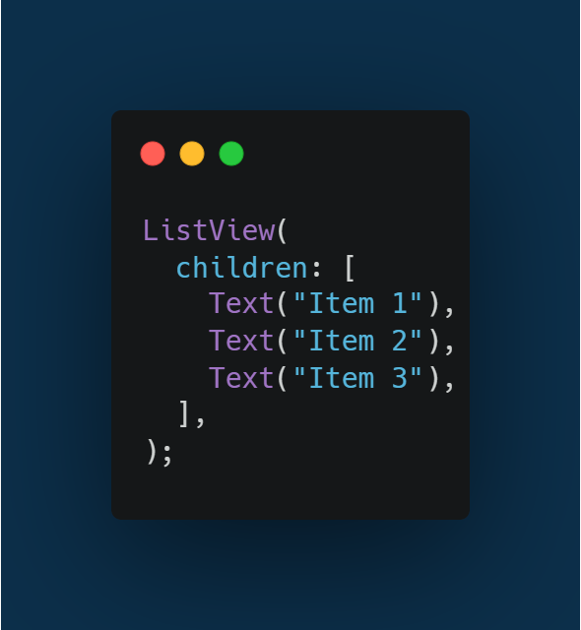
List View
Used for a small, fixed number of items

Slide 4
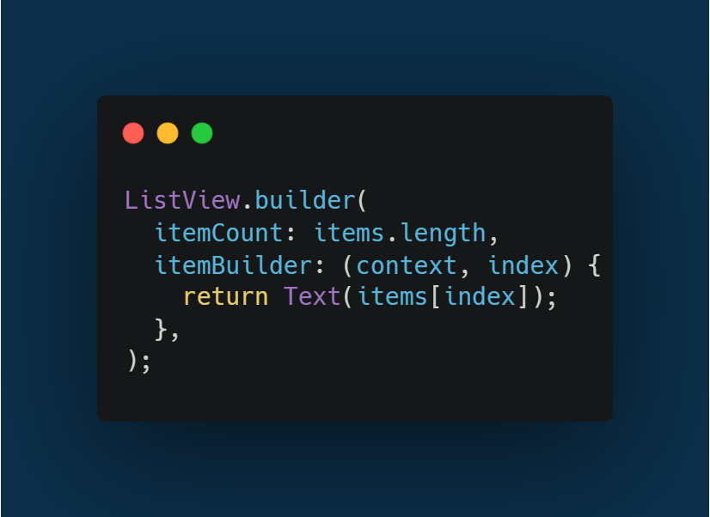
ListView.builder
Best for large lists. Builds items lazily when needed

Slide 5
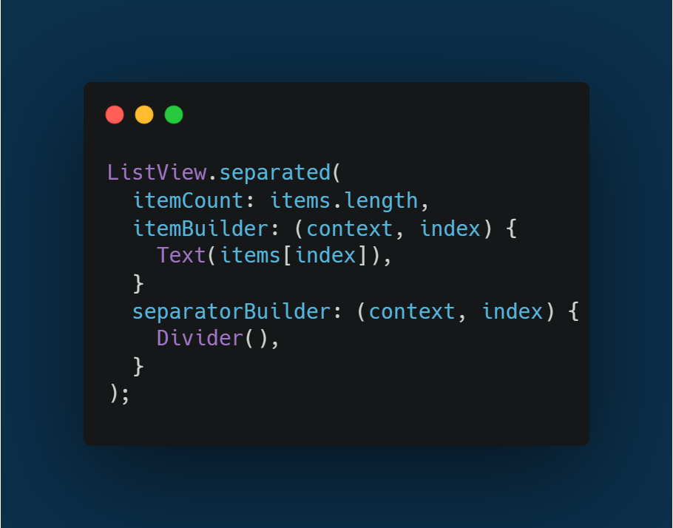
ListView.separated
Same as builder but adds a separator between items.

Slide 6
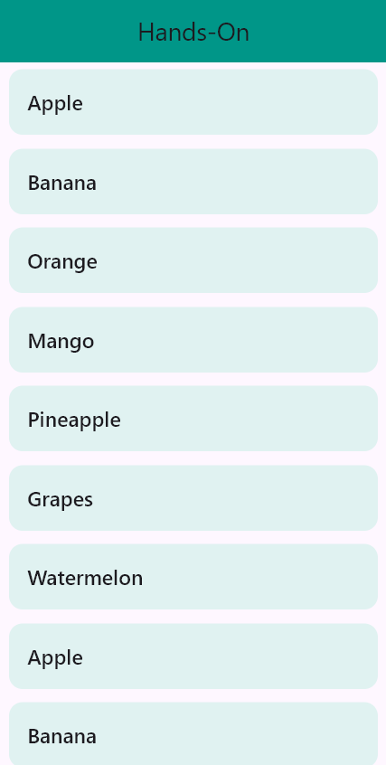
Hands on

Slide 7
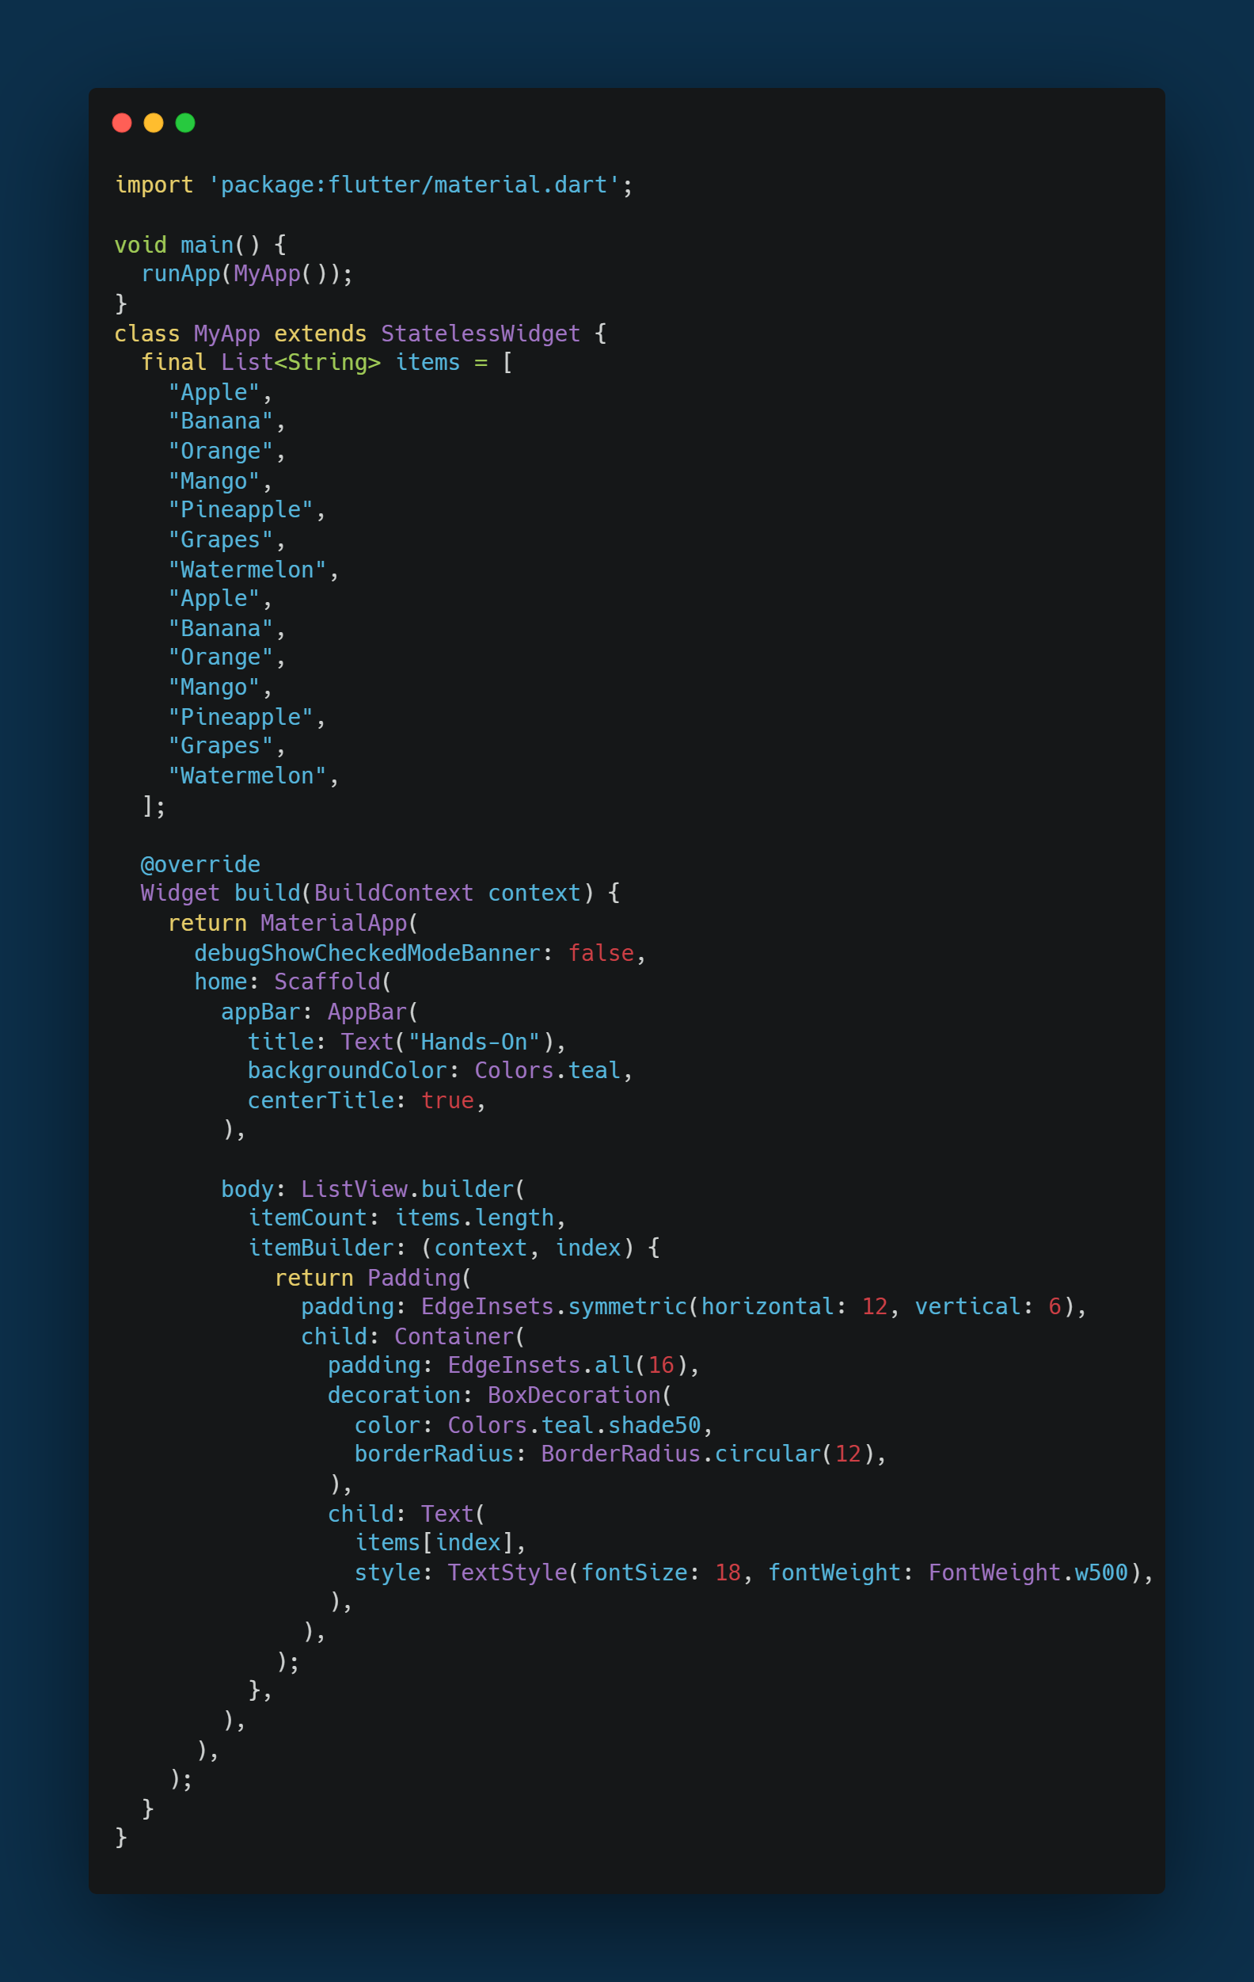

Slide 8
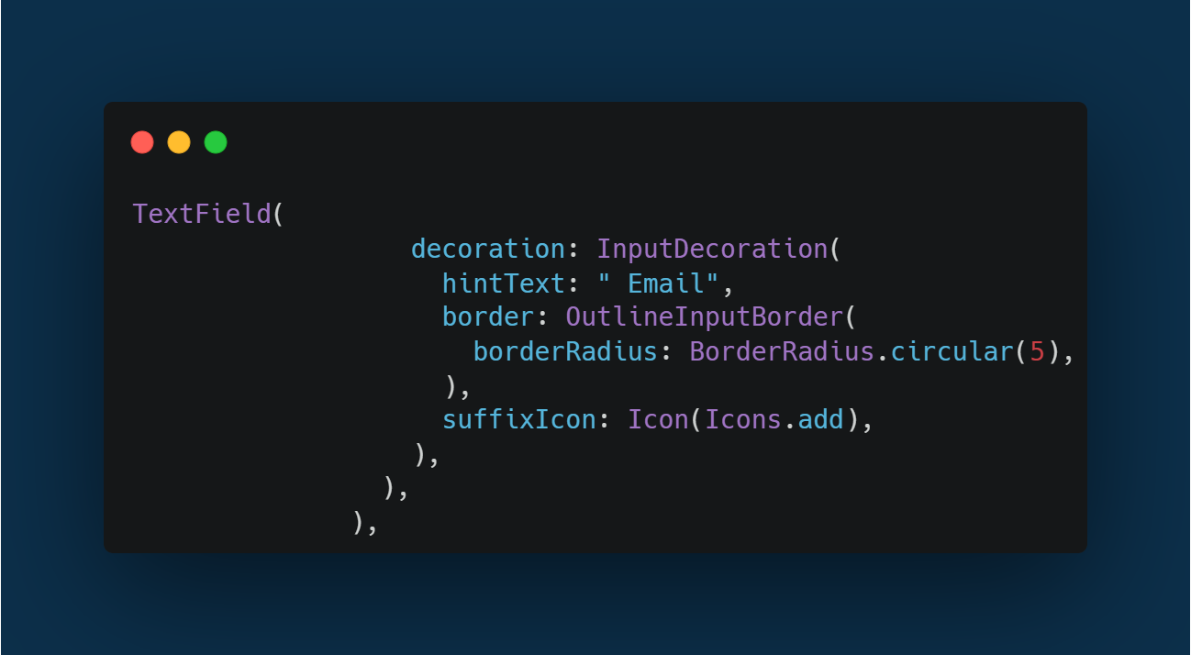
Text Field
A text field lets the user enter text, either with hardware keyboard or with an onscreen keyboard.

Slide 9
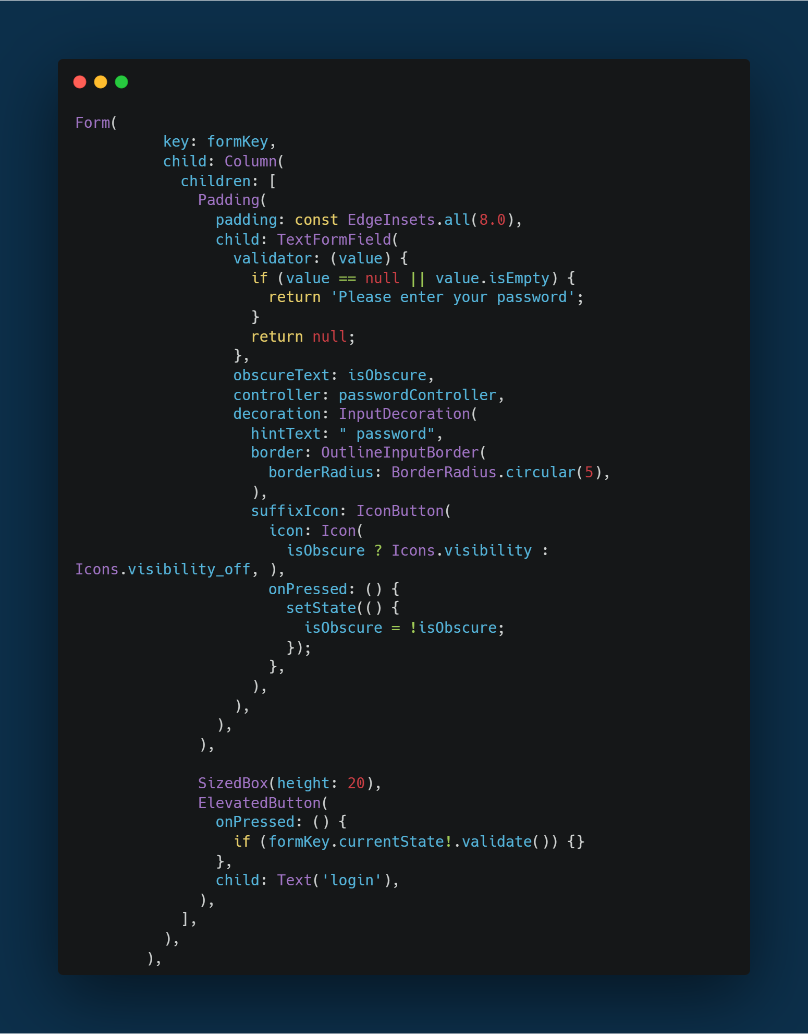
Text Form Field
A text field lets the user enter text, either with hardware keyboard or with an onscreen keyboard.
Validator : An optional method that validates an input

Slide 10
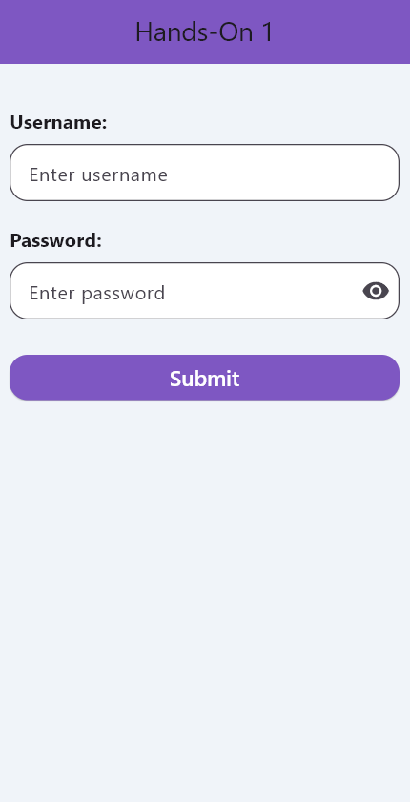
Hands on

Slide 11
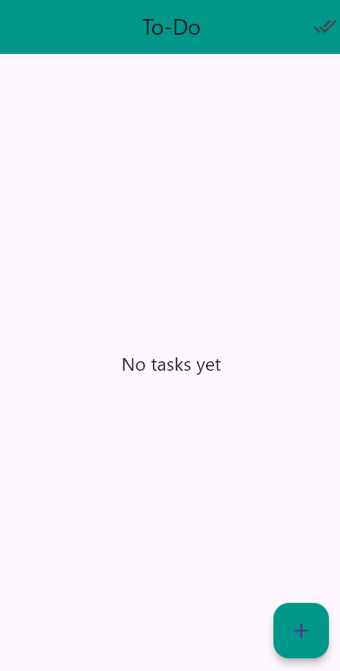
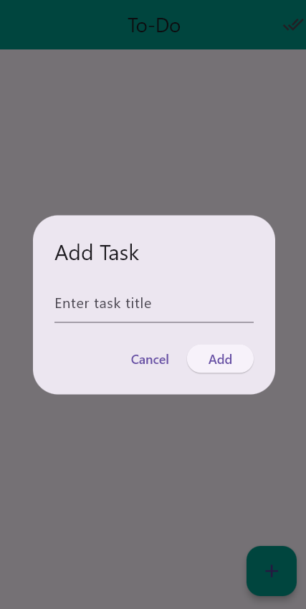
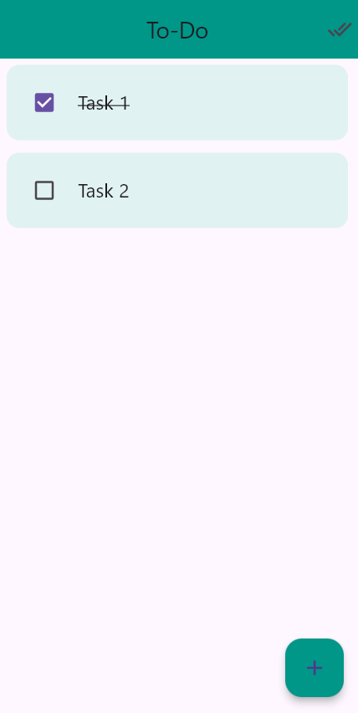
ToDo App

Slide 12
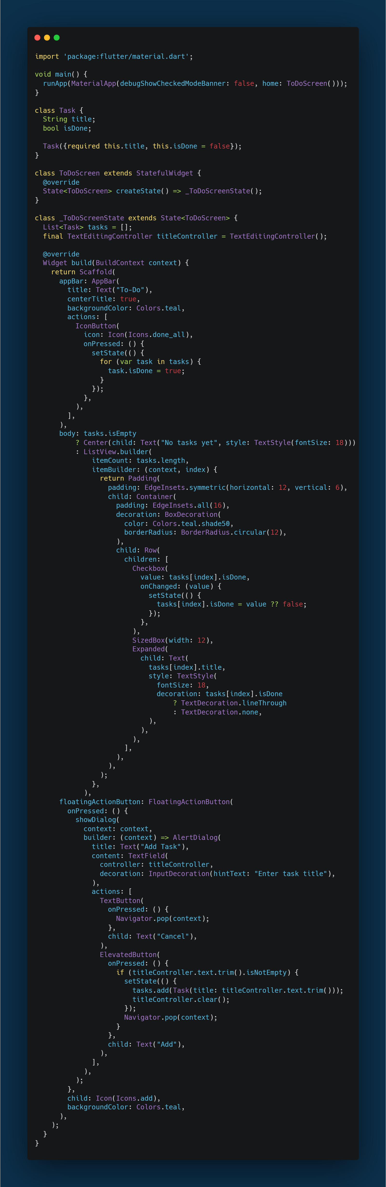

Slide 13
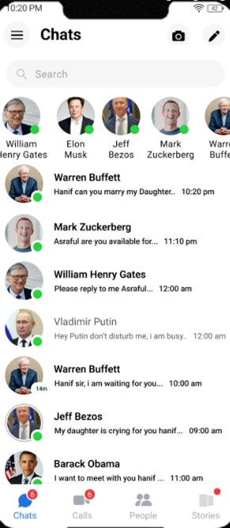
Hands on

Slide 14
Thank you!

